Slide 1
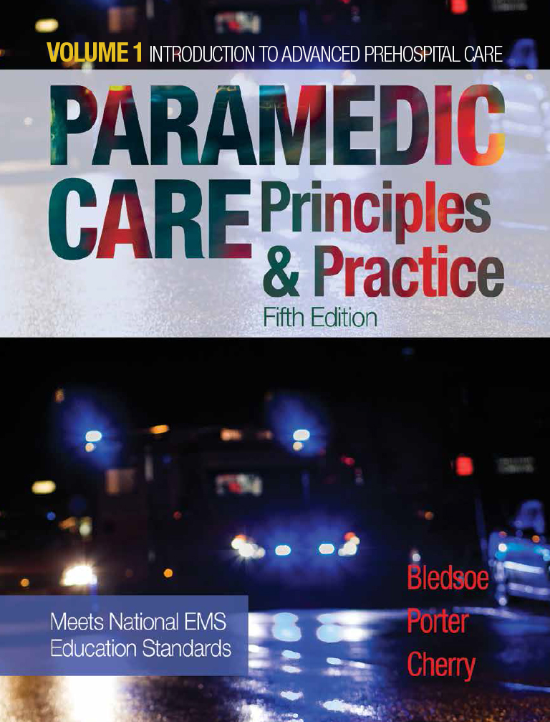
Paramedic Care: Principles & Practice
Fifth Edition
Chapter 1
Introduction to Paramedicine
Copyright © 2017, 2013, 2009 Pearson Education, Inc. All Rights Reserved
Notes:
If this PowerPoint presentation contains mathematical equations, you may need to check that your computer has the following installed:
1) MathType Plugin
2) Math Player (free versions available)
3) NVDA Reader (free versions available)

Slide 2
Standard
Preparatory (E M S Systems)

Slide 3
Competency
Integrates comprehensive knowledge of E M S systems, the safety and well-being of the paramedic, and medical–legal and ethical issues, which is intended to improve the health of E M S personnel, patients, and the community.

Slide 4
Introduction (1 of 11)
Emergency Medical Services (E M S)
Paramedic:
Highly trained health care professional
Provides comprehensive, compassionate, efficient prehospital emergency medical care
Notes:
Teaching Tips
Before starting the Introduction, ask students to list on the board what roles the paramedic serves, and how they help the public.

Slide 5
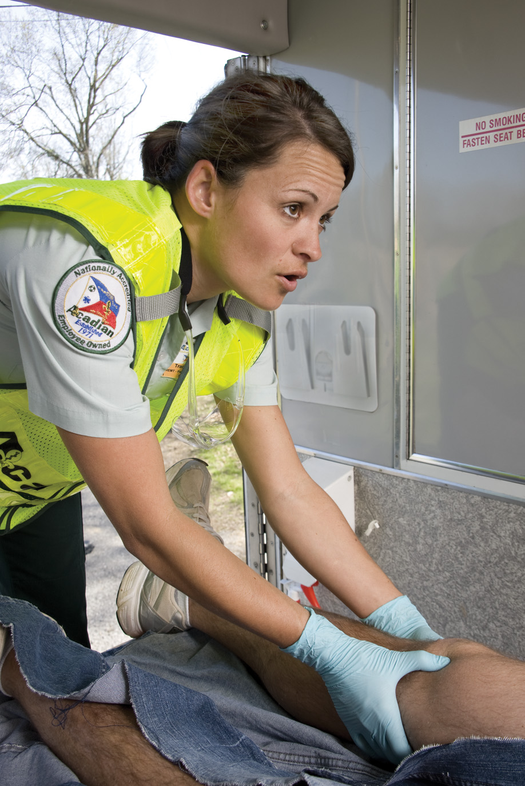
Figure 1-1 The Paramedic of the Twenty-first Century is a Highly Trained Health Care Professional

Slide 6
Introduction (2 of 11)
Description of the Profession
Levels of E M S Providers
Emergency Medical Responder (E M R): immediate lifesaving care to critical patients.
Emergency Medical Technician (E M T): basic emergency medical care; transportation for critical and emergent patients.
Notes:
Discussion Topics
List the four levels of EMS, what each level can do, and the skills each level is not permitted to perform.

Slide 7
Introduction (3 of 11)
Description of the Profession
Levels of E M S Providers
Advanced Emergency Medical Technician (A E M T): basic and limited advanced emergency medical care; transportation for critical and emergent patients.
Paramedic: advanced emergency medical care for critical and emergent patients; complex decision making.

Slide 8
Introduction (4 of 11)
The Modern Paramedic
Encompass the disciplines of health care, public health, and public safety
Provides emergency medical care in out-of-hospital setting
Makes accurate independent judgments
Has appropriate licensing or credentialing

Slide 9
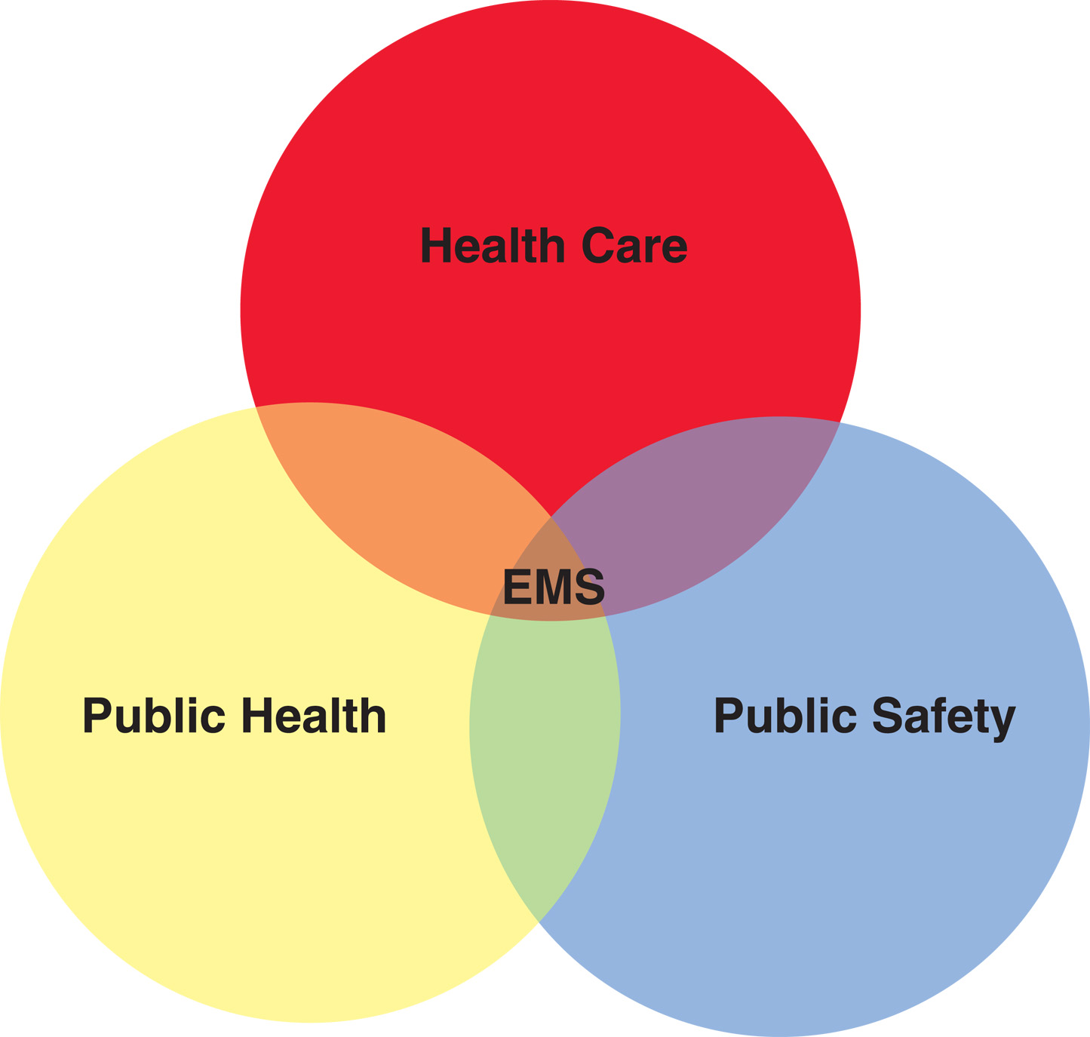
Figure 1-2 Modern E M S is a Combination of Public Health, Public Safety, and Health Care

Slide 10
Introduction (5 of 11)
The Modern Paramedic
Functions under direction of E M S system's medical director
Knowledge, skills, attitudes consistent with expectations of public and profession
Component in continuum of care

Slide 11
Introduction (6 of 11)
Link between health resources
Maintains high-quality health care at reasonable cost
Advocates for patient
Ensures patient receives best possible care without regard to ability to pay or insurance status

Slide 12
Introduction (7 of 11)
Public education, health promotion, participation in injury and illness prevention programs
Mobile integrated health care (community paramedicine): function outside customary emergency response and transport roles
Notes:
Class Activities
Ask students to list all the illness and injury prevention programs they can think of.
Discuss with them the ways they can participate in these programs as paramedics.
Examples include but are not limited to:
- DARE
- Safety Town
- Bike Rodeos
- Blood Pressure Screenings
- MADD
- Mock Auto Accidents at Schools
- First Aid/CPR
- Babysitting Courses
- No Texting and Driving

Slide 13
Introduction (8 of 11)
Paramedic Characteristics
Flexible
Confident leader
Excellent judgment
Prioritizes decisions
Develop rapport with wide variety of patients
Functions independently
Notes:
Class Activities
Have students give examples of situations where they had to be flexible in their job.
Class Activities
Have students list skills they learned as EMTs that they have not used since class.
If time permits, pull that equipment out and have a few students attempt to use it only by memory.

Slide 14
Introduction (9 of 11)
The Paramedic: A True Health Professional
Continuing education programs
Reviews and practice skills and procedures
Peer evaluation
Active role in professional and community organizations
Notes:
Class Activities
Have one student change into a dirty shirt (an old shirt that you provide, spill coffee on it, ink stains, etc.) and perform a patient assessment.
Have another student perform an assessment using a poor attitude and no listening skills.
Discuss with students their initial impressions.
Class Activities
Have students give examples of how they can review their performance.
Take students through a mock run review using an imaginary call that you make up.

Slide 15
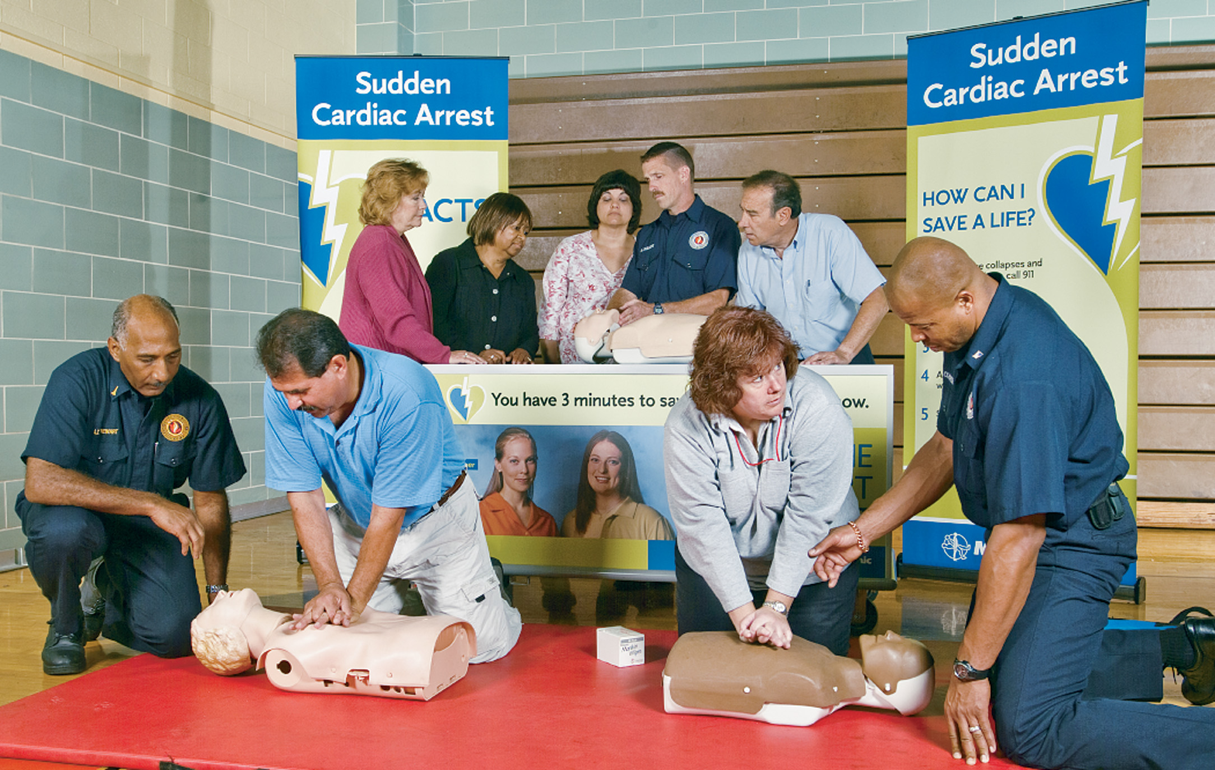
Figure 1-5a Public Education is an Important Part of the Paramedic’s Job

Slide 16
Introduction (10 of 11)
The Paramedic: A True Health Professional
National Emergency Medical Services Education Standards: Paramedic Instructional Guidelines
Participates in research
Acceptance and adherence to code of professional ethics and etiquette
Notes:
Teaching Tips
Just briefly touch on research, since this will be discussed in later chapters.
Focus on the changes research initiated, such as CPR and compressions first, O₂ for chest pain/MI patients with low PSO₂ saturations, rapid transport, and decreased scene time for stroke victims and trauma victims, etc.

Slide 17
Introduction (11 of 11)
The Paramedic: A True Health Professional
Emergency patient always the primary concern
Cross training: fire fighter and police officer; participate in rescue operations, directing traffic, and other tasks on emergency scene
Notes:
Teaching Tips
Stress to students that, even if they are cross trained, they will be providing only one service at a time.

Slide 18
Expanded Scope of Practice (1 of 9)
911 response
Critical care transport
Helicopter air ambulance
Tactical E M S
Notes:
Teaching Tips
See if you can have a paramedic who is trained in extended scope of practice speak to students briefly about their positions.

Slide 19
Expanded Scope of Practice (2 of 9)
Mobile integrated health care
Industrial medicine
Sports medicine
Corrections
Hospital emergency departments
Notes:
Teaching Tips
See if you can have a paramedic who is trained in extended scope of practice speak to students briefly about their positions.

Slide 20
Expanded Scope of Practice (3 of 9)
Critical care transport (C C T): vehicles to move patients between facilities.
Specialized ground ambulances
Fixed-wing aircraft
Helicopters
Large vehicles mounted on truck chassis

Slide 21
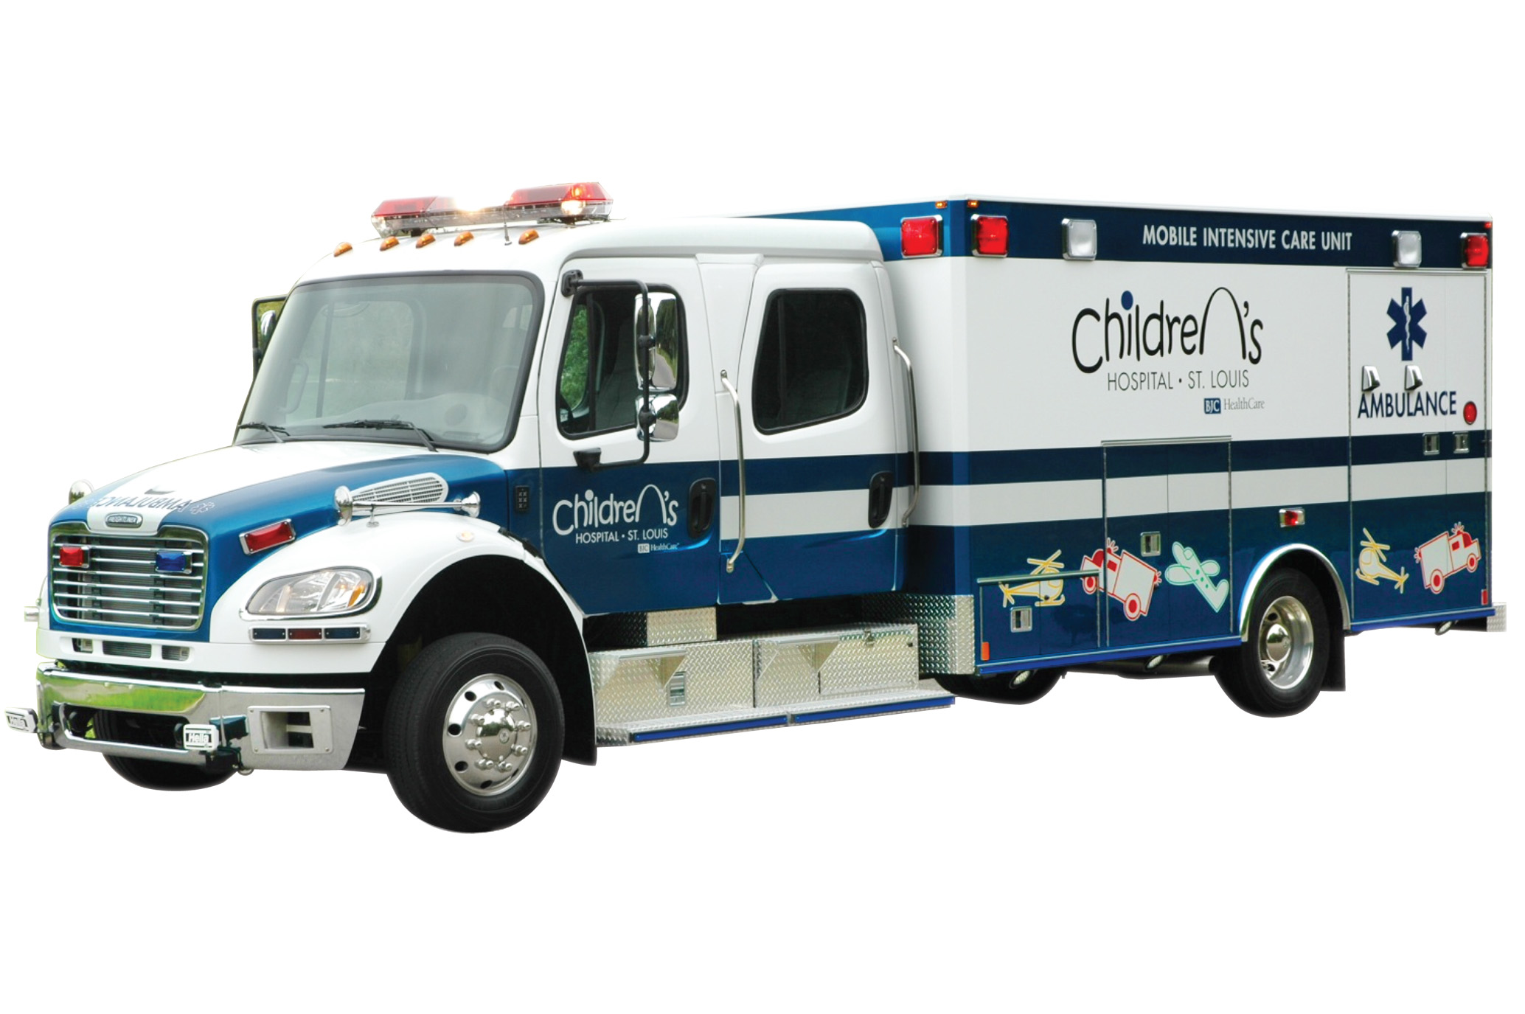
Figure 1-6 The Modern Critical Care Transport Vehicle Provides Virtually All the Capabilities of the Hospital Intensive Care Unit

Slide 22
Expanded Scope of Practice (4 of 9)
Helicopter Air Ambulance (H A A)
Staff with two medical crew members and often include paramedics.
Flight paramedic typically will respond to both scene calls and interfacility transfers.

Slide 23
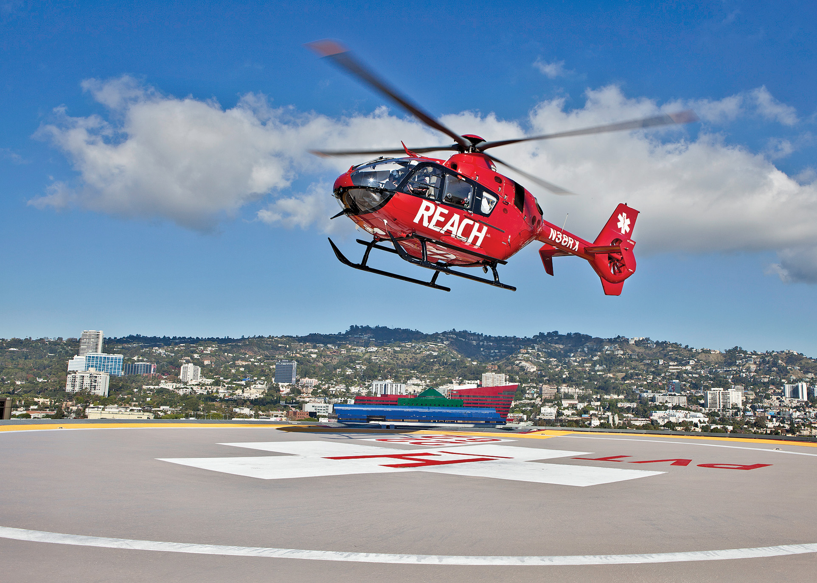
Figure 1-8 The Helicopter has Become an Important Part of the Modern E M S System
(© Reach Air medical Services, L L C)

Slide 24
Expanded Scope of Practice (5 of 9)
Tactical E M S
Enhance safety of special operations personnel and public
Cross trained as police officers; carry weapons
Life-saving care (dangerous environments); patient safely evacuated to E M S

Slide 25
Expanded Scope of Practice (6 of 9)
Mobile Integrated Health Care
In close contact with medical direction, provide care at scene without transport to hospital
Specialized crews to periodically assess and monitor high-risk patients in community

Slide 26
Expanded Scope of Practice (7 of 9)
Industrial Medicine
Safety inspection
Accident prevention
Medical screening of employees
Vaccinations and immunizations
Increased employee safety
Decreased time lost from work

Slide 27
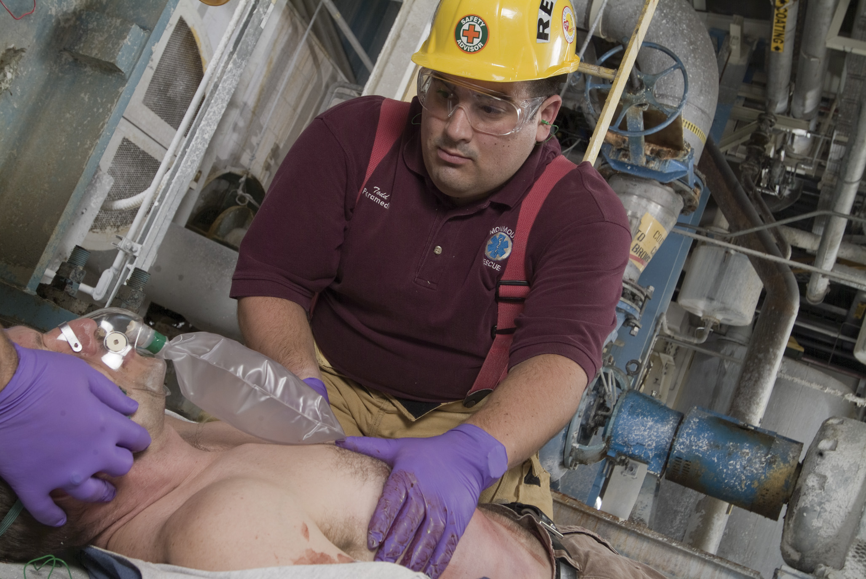
Figure 1-11 The Industrial Paramedic Provides Several Important Services in Addition to Emergency Care

Slide 28
Expanded Scope of Practice (8 of 9)
Sports Medicine
Injury prevention
Injuries specific to sports
Corrections Medicine
Initial prisoner medical intake assessment
Oversee medical needs of prison population; emergencies

Slide 29
Expanded Scope of Practice (9 of 9)
Hospital Emergency Departments
Role varies state to state
Assist medical and nursing staff with skills and responsibilities within scope of paramedicine

Slide 30
Summary (1 of 2)
E M S recognized as staple in health care system.
Paramedics identified as underutilized medical experts.
As scope of practice for paramedicine continues to expand, so will demand for skilled practitioners.

Slide 31
Summary (2 of 2)
Paramedic first member of health care system with whom patient interacts.
Results can affect patient's opinion of health care system in general.
E M S is a profession in which you can make a difference.
Every call and every patient interaction has the potential to make the difference between life and death.

Slide 32
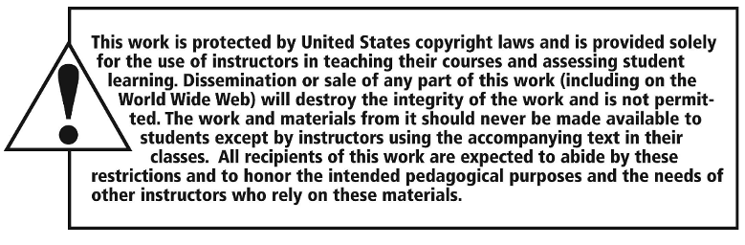
Copyright

